Slide 1

Google App Store Analysis Detailed Project Report
Ra
by Rushikesh Khandare

Slide 2

Project Details:
Project Title
Analyzing Google Apps Store dataset in terms of app downloads and ratings.
Technology
Business intelligence
Domain
Technology
PDifficulty level
Advanced

Slide 3

Analyzing Google Apps Store Dataset
1
Objective
The objective involves applying various business intelligence tools such as Tableau or Power BI to understand insights from the data effectively.
2
Problem Statement
The widespread use of technology, particularly the android mobile operating system, necessitates an in-depth analysis of key features and functionalities. This analysis aims to unveil crucial insights.

Slide 4

Insight Generation
1
Technological Dominance
2
Data Mining
Technology has become an integral part of daily life, influencing different aspects of our routine through devices like smartphones and tablets.
Utilizing data mining techniques, critical metrics and factors can be extracted from vast datasets, enabling the discernment of meaningful relationships between attributes.

Slide 5

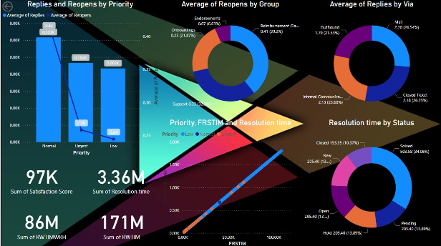
Dataset Analysis Approach
Tools Utilization
Visual Understanding
Utilizing tools like Tableau or Power BI to visualize data and gain deep insights.
Visualizing data using modern technology to gain a clear understanding of trends and patterns.

Slide 6



Data Mining Results
Data Extraction
Insightful Relationships
Trend Analysis
Extracted significant insights through data mining techniques.
Analyzed trends within the dataset to gain valuable insights.
Identified meaningful relationships between various attributes.

Slide 7
Data Visualization Tools
1
2
Data Representation
Insightful Insights
Visualized data to represent the unique attributes and metrics within the dataset.
Provided deep insights into the dataset through effective visualization techniques.

Slide 8

Enhancing Technological Insights
Interactive Visualization
Data-Driven Decision Making
Implementing interactive visualization methodologies to gain an in-depth understanding of technology trends.
Utilizing data-driven visual insights to make informed decisions within the technology domain.

Slide 9
Technology Integration
Integration of Technology
Utilized modern technology integration for comprehensive data analysis.
Data-Driven Approach
Applied a data-driven approach to technology analysis for robust insights.

Slide 10
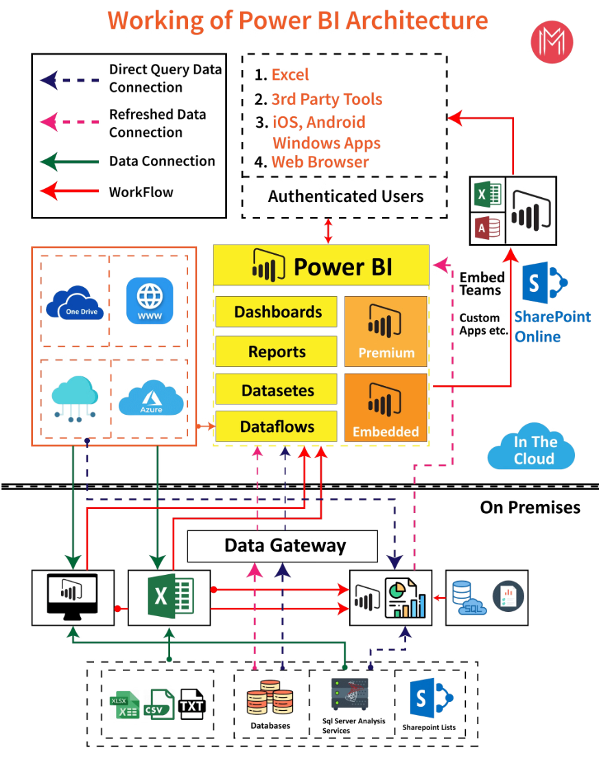
Architecture

Slide 11
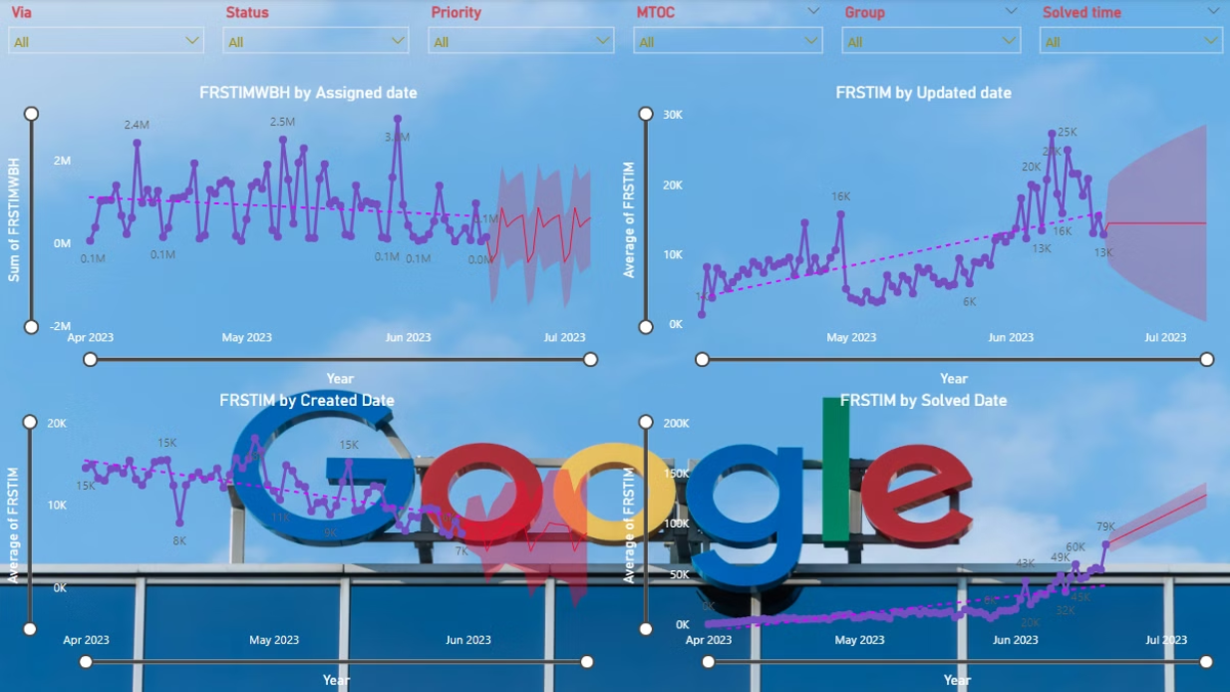
Insights
Forcast

Slide 12
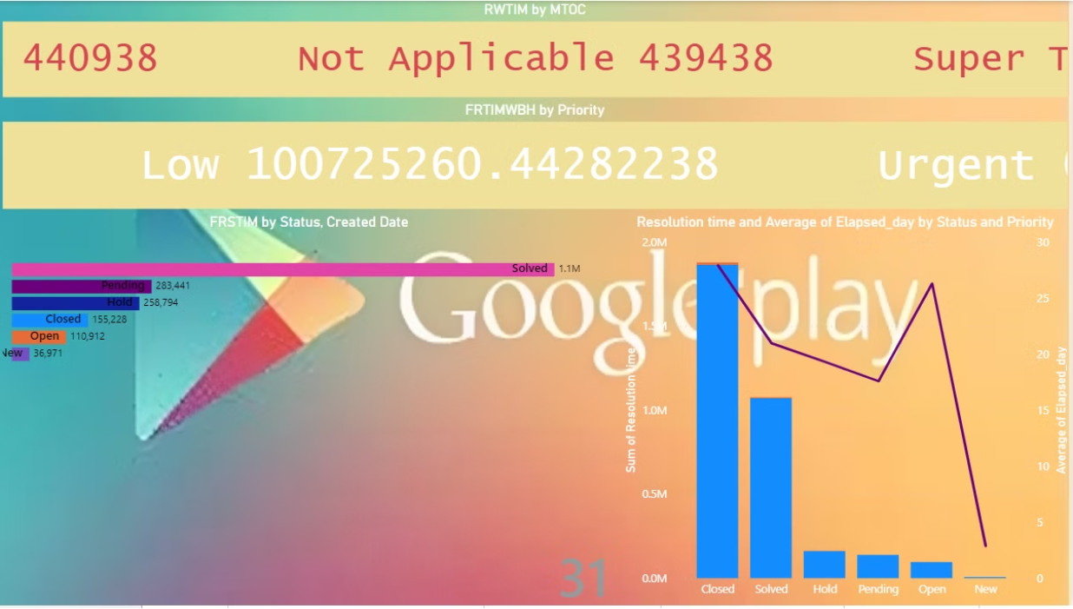
Insights
Animated

Slide 13
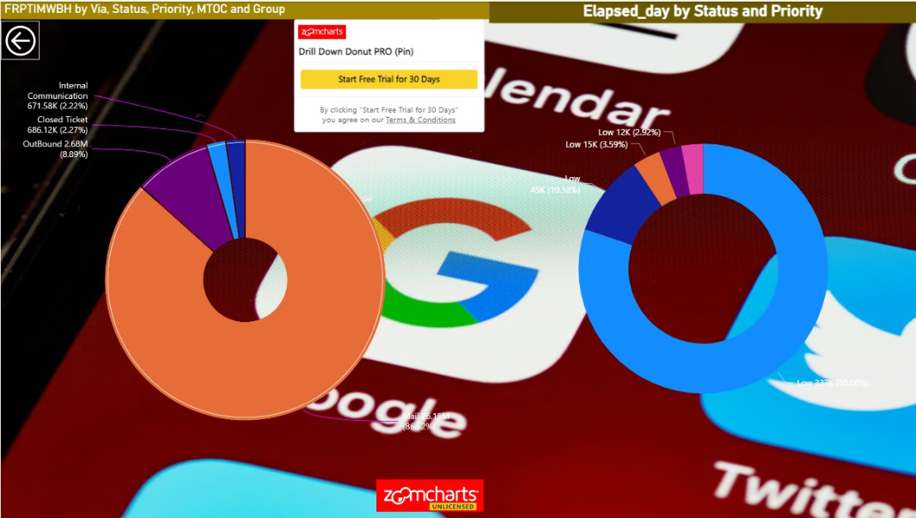
Insights
Drill Down Donut

Slide 14
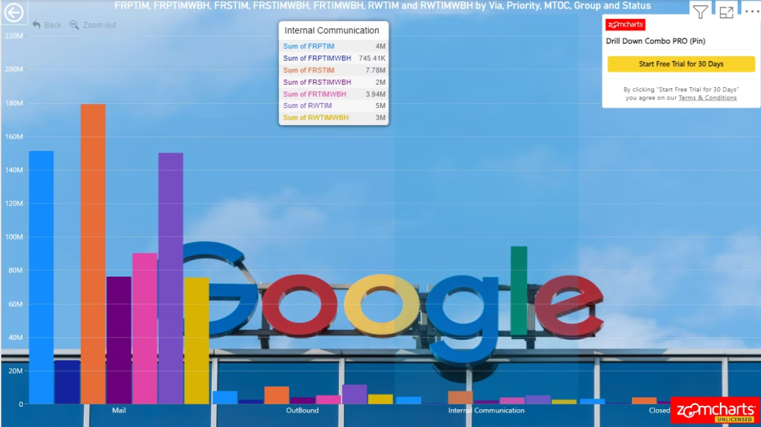
Insights
Drill Down column

Slide 15
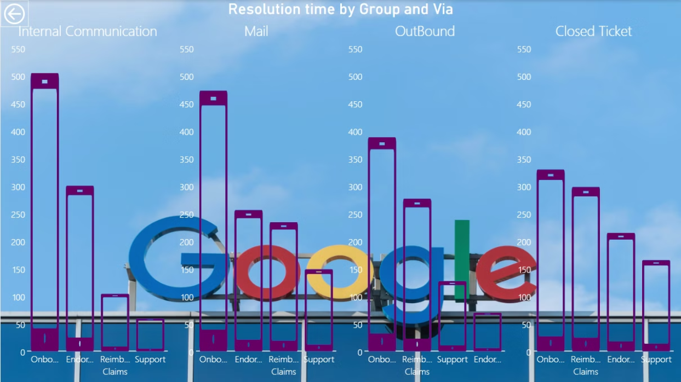
Insights
Infographic

Slide 16
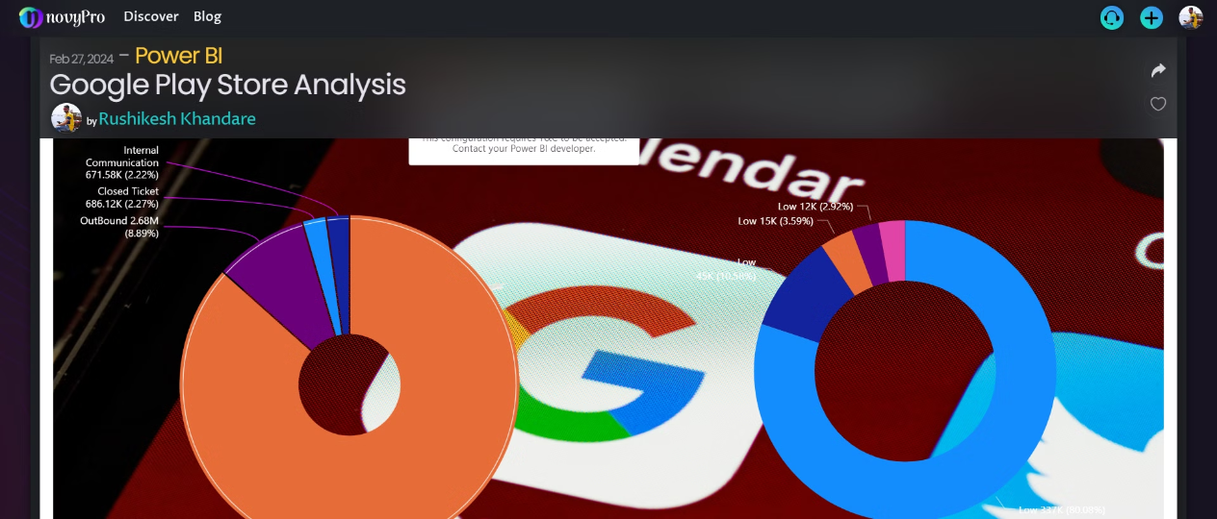
NovyPro Dashboard

Slide 17
QUESTIONS
Q1) What’s the source of data?
The dataset is taken from ineuron
Q2) What was the type of data?
The data was the combination of numerical and Categorical values.
Q 3) What techniques were you using for data pre-processing?
Removing unwanted attributes
Visualizing relation of independent variables with each other and output variables
Checking and changing Distribution of continuous values
Removing outliers
Cleaning data and imputing if null values are present.

Slide 18

Thank you

